Slide 1
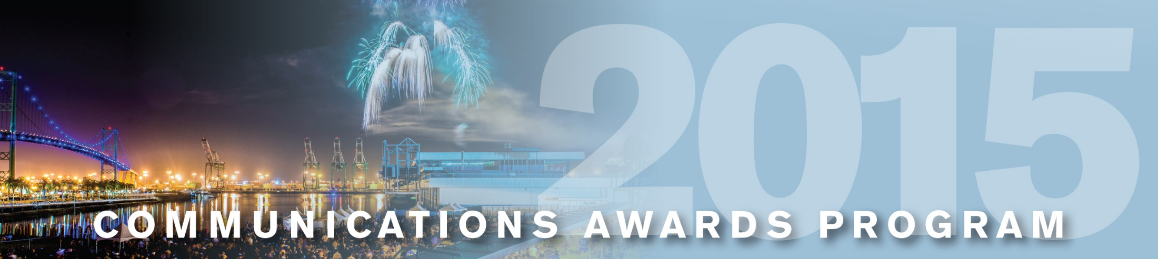
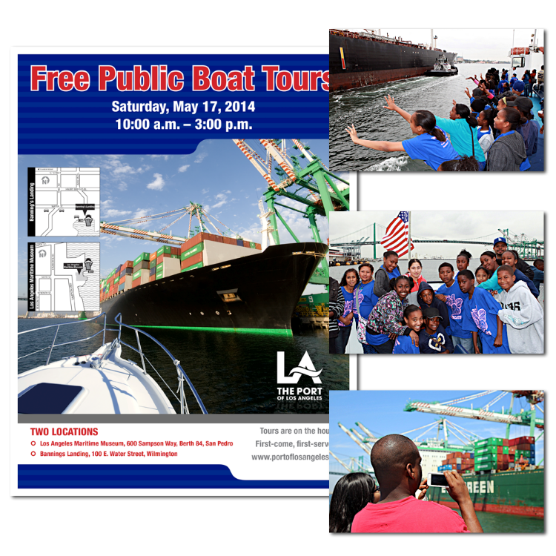
Port of
Los Angeles
Annual World Trade Week Public Boat Tours
Special Events

